Slide 1


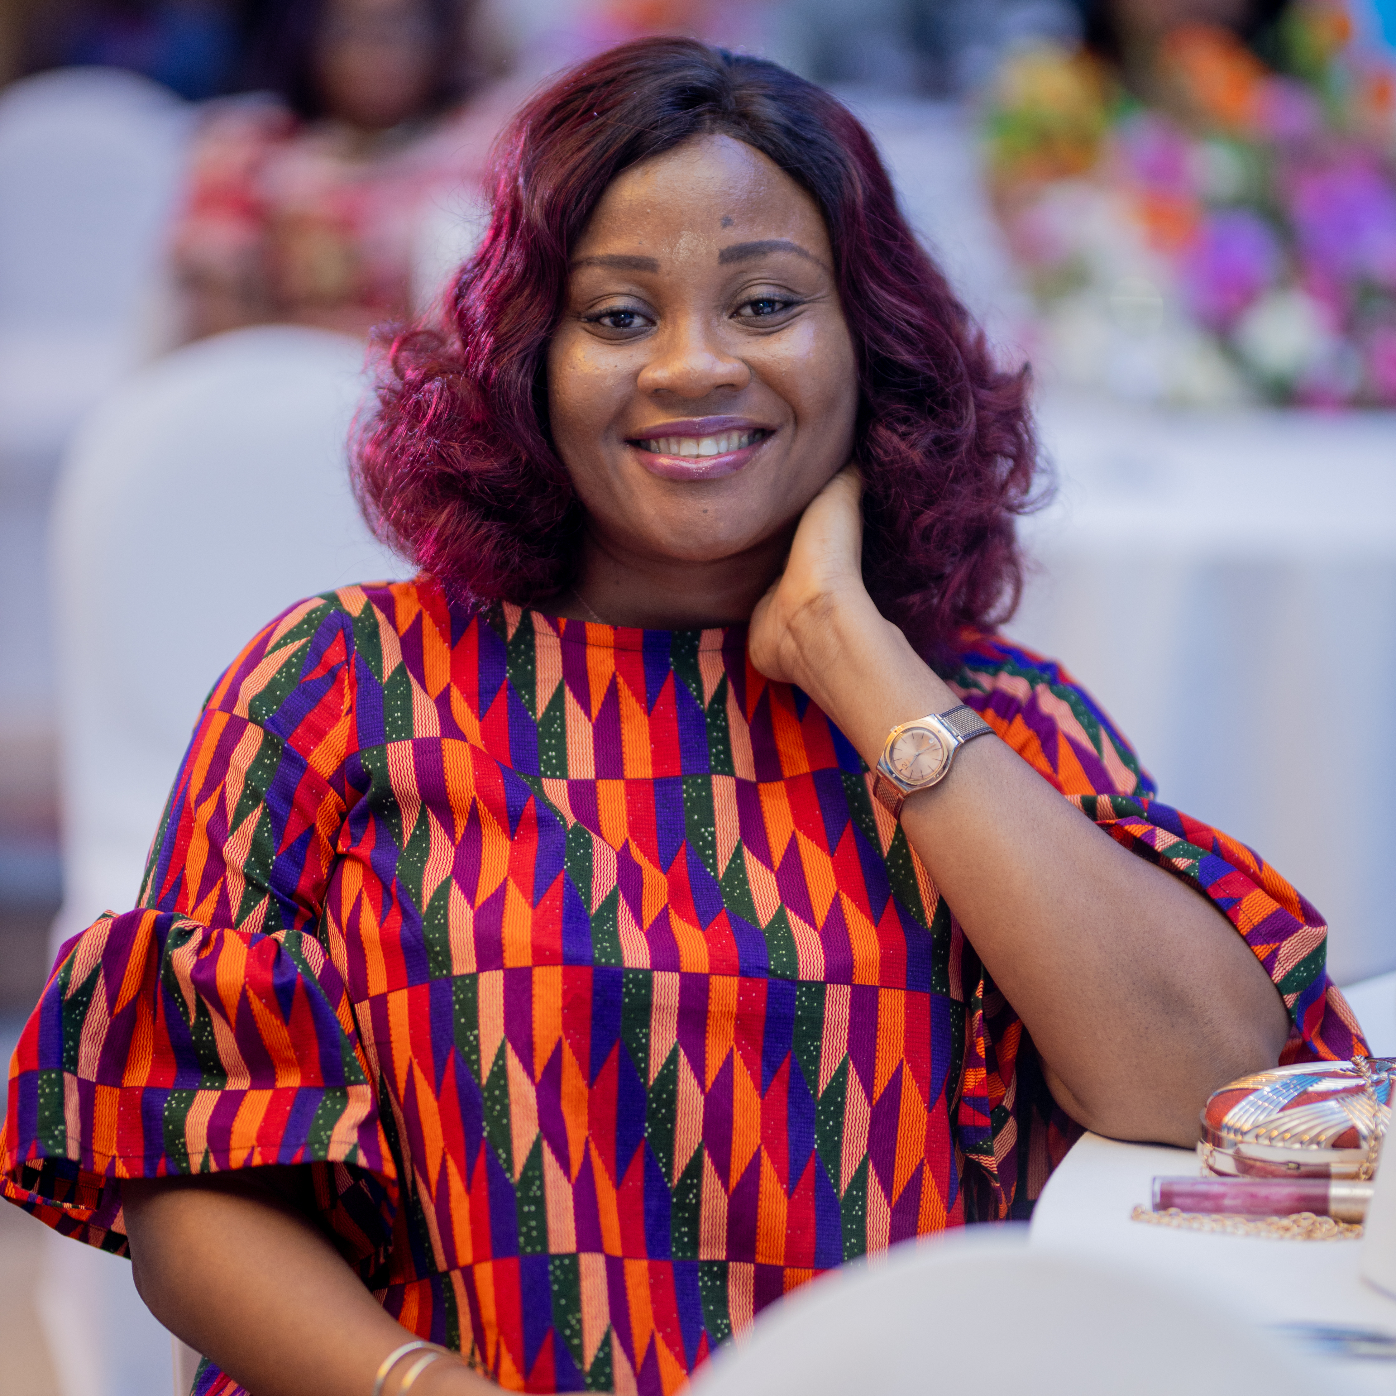
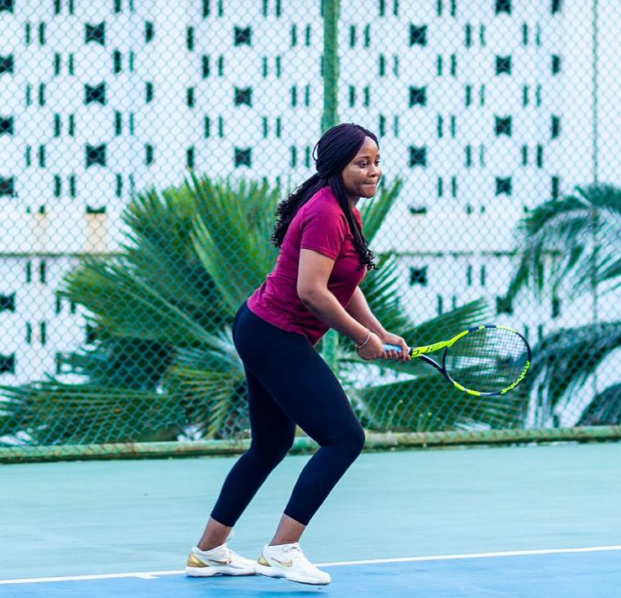
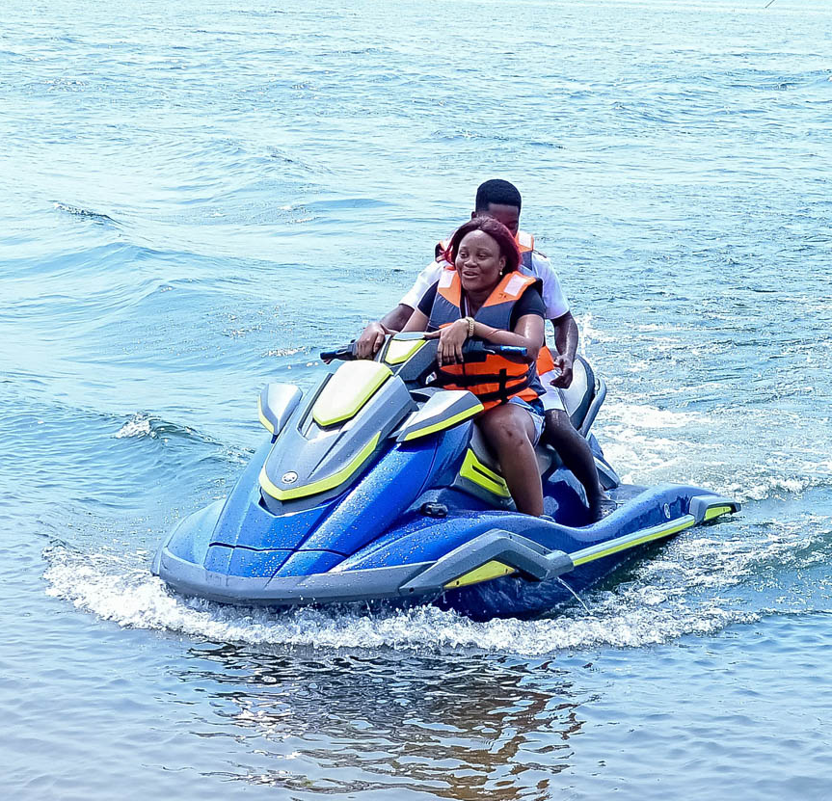
Getting to Know Me
Work
Personal
My role
Country Communications Manager
Significant others/family members / furry friends in my life
Mother and Husband
Tenure in ofi/Olam
5 years
How I enjoy spending my free time
Spending time alone to recharge and playing tennis
Previous companies I have worked at
Ghana Broadcasting Corporation
My favorite / comfort food
Anything delicious is good for me
Why I joined ofi/Olam and what keeps me here?
I joined ofi because I wanted an advancement in my career. After 5 years, I have seen progression in my career; I have job security and stability as well as personal growth
My favorite song
Any song written with heart and emotions is good for me!
Francisca Bannerman
‘Franca’
A few fun facts about me
My favourite colour is green. I love adventure, and I stay true to what I believe in.
This is me outside work, doing stuff I enjoy in my life …

